Slide 1


A Major Project on Prediction of Air pollution Using Machine Learning Algorithm
CMR Technical Campus
UGC AUTONOMOUS
Accredited by NBA & NAAC with A Grade
Approved by AICTE, New Delhi and Affiliated to JNTU, Hyderabad
Department of Information Technology
Under the Guidance of
D.Mahesh Babu
(Assistant Professor)
Presented by
K.Laharika(207R1A1221)
V.Bangaru(207R1A1257)
J.Lokesh(207R1A1220)
A.Deekshith(217R5A1203)

Slide 2
A
Contents
Abstract
Introduction
Existing System
Existing System-Disadvantages
Proposed System
Proposed System-Advantages
Software/Hardware Requirements
Modules
Architecture
UML Diagrams
Data Flow Diagram
Screen Shots
Conclusion
Bibliography

Slide 3
A
Abstract
Air quality degradation is a critical issue in developing and urban areas due to pollution from transportation, power generation, and other sources.
Rapid population growth and economic development exacerbate environmental problems like air and water pollution.
Major pollutants affecting air quality include Nitrogen Oxide, Carbon Monoxide, Particulate Matter (PM), and Sulphur Dioxide (SO2).
Carbon Monoxide (CO) originates from incomplete combustion of fuels such as petroleum and gas.
Nitrogen Oxide (NO) is generated through the burning of fossil fuels.
Sulphur Dioxide (SO2) significantly contributes to air pollution, posing health risks to humans.
Air quality assessment faces challenges due to various factors like location, time, and other ambiguous boundaries.
AI-based approaches offer potential solutions for predicting air quality levels accurately.
Machine learning algorithms can be employed to forecast air pollution levels effectively.
The objective is to develop AI models for precise air quality prediction, improving understanding of air pollution's impacts on human health and the environment by using AI-based strategies.

Slide 4
Introduction
The environment is everything around us, but human activities like driving cars and running factories are making it dirty.
Pollution from things like cars and factories makes the air and noise around us worse.
When it's more humid, it gets hotter, making pollution even worse.
Most of the pollution comes from vehicles and industries, making up about 75% of the bad stuff in the air, like NO, CO, and SO2.
Cities getting bigger, more cars on the road, and more factories are making the air worse.
We collected data on things like how many cars there are and how much pollution there is in different parts of Delhi.
This data helps us understand how pollution happens in different areas, so we can find ways to stop it.
Our goal is to use this data to make predictions about pollution levels, so we can take action to keep our environment clean and healthy.

Slide 5
Existing System
The current Air Quality Index (AQI) system, while providing information on pollution levels, has several drawbacks.
AQI focuses primarily on health impacts based on pollutant concentrations and exposure duration, but its effectiveness varies across countries due to different air quality standards.
The system's reliance on national standards leads to inconsistencies in assessing pollution risks, potentially underestimating health hazards in certain regions.
Moreover, the AQI system may not adequately account for emerging pollutants or their health effects, leaving gaps in understanding and response.
Users may find it challenging to interpret AQI values accurately, leading to confusion or misunderstanding about pollution levels and associated risks.
Furthermore, the AQI system lacks real-time predictive capabilities, limiting its usefulness for proactive pollution management and public health protection.

Slide 6
Existing System
Disadvantages:
It is insecure System.
It does’nt contain efficiency.
Does’nt give accuracy(no accuracy).
It may not provide real-time information, so people might not know the exact pollution levels at the moment

Slide 7
Proposed System
Data Collection:
We start by gathering data from reliable sources, such as the Delhi Government’s website. We then closely examine this data, identifying any significantly different data points, checking for consistency, and dealing with any missing values. This is a crucial step in our project.
If we find any missing data, we fill it in using the average value of that particular data attribute. To make accurate predictions using a statistical method called regression, we need to estimate future values for various parameters.
Once all the parameters are available, we use linear regression to predict the Air Quality Index (AQI). Finally, we check if our model fits the data well. We do this by calculating the root mean square error and the absolute percentage error. These calculations help us determine if our model is accurate

Slide 8
Proposed System
Experimentation:
Numerous experiments were conducted to determine the best network structure and parameters for the neural network.
It was found that a neural network with one hidden layer and two nodes produced the smallest mean absolute error among various tested neural network structures.
Support Vector Regression and a multilayer perceptron with back-propagation also provided slightly better predictions compared to linear regression.
The k-Nearest Neighbor algorithm performed the least accurately among the four methods.
All experiments were carried out using a 10-fold cross-validation approach to ensure robustness and accuracy in the results.

Slide 9
Proposed System
Advantages:
The proposed system implemented Linear Regression is basically use for predicting the real values data y using continuous parameter.
It is more secure and security.
It is effectiveness.
It gives accurate results.
2/10

Slide 10
Software/Hardware Requirements
Hardware requirements:
System : Intel I-3 Processor
Hard Disk : 512 GB
Monitor : 14’Colour Monitor
Ram : 8GB
Software Requirements:
Operating System : Windows 10
Coding Language : Python
Software Environment : Anaconda/PyCharm
Modules : Opencv, Numpy
Back-End : Django-ORM
❖ Designing : Html, css, javascript.
❖ Data Base : MySQL (WAMP Server).

Slide 11
Modules
Service Provider
In this module, the Service Provider has to login by using valid user name and password. After login successful he can do some operations such as Login, Train Data Sets and View Child Birth Prediction, View Train and Test Results, View Predicted Air Quality/Pollution Details, Find Air Quality/Pollution Prediction Ratio on Data Sets, Find Air Quality/Pollution Prediction Ratio Results, Download Trained Data Sets, View All Remote Users
View and Authorize Users
In this module, the admin can view the list of users who all registered. In this, the admin can view the user’s details such as, user name, email, address and admin authorizes the users.
Remote User
In this module, there are n numbers of users are present. User should register before doing any operations. Once user registers, their details will be stored to the database. After registration successful, he has to login by using authorized user name and password. Once Login is successful user will do some operations like REGISTER AND LOGIN, PREDICT USED CAR PRICE TYPE, VIEW YOUR PROFILE.
2/10

Slide 12
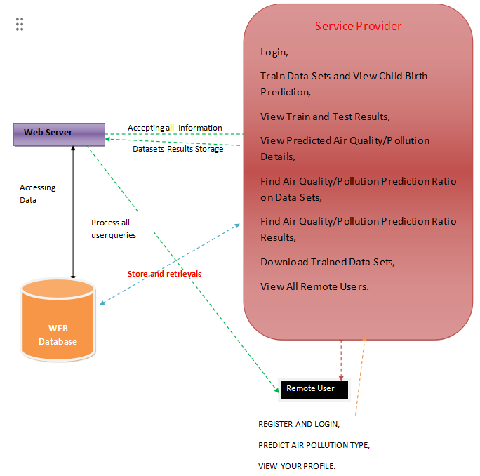
Architecture
2/10

Slide 13
Algorithms Used
1. SVM (Support Vector Machine):
SVM is another machine learning algorithm commonly used for both classification and regression tasks. It works by finding the best possible line or hyperplane that separates different classes in the data. SVM aims to maximize the margin, which is the distance between the hyperplane and the nearest data points from each class. It's effective in high-dimensional spaces and is especially useful when the data is not linearly separable.
2. Logistic Regression:
Despite its name, logistic regression is a classification algorithm, not a regression algorithm. It's used to predict the probability that an instance belongs to a particular class. It works by fitting a logistic function to the input data, which maps input features to the probability of a binary outcome. Unlike linear regression, logistic regression predicts probabilities using a sigmoid function and outputs values between 0 and 1.
3. K Nearest Neighbors (KNN) Classifier:
KNN is a simple and intuitive algorithm used for classification tasks. It operates on the principle of similarity: instances with similar features tend to belong to the same class. In KNN, the class of a new data point is determined by the majority class among its nearest neighbors (hence the name). The value of K specifies the number of nearest neighbors considered for classification.
nition.
2/10

Slide 14
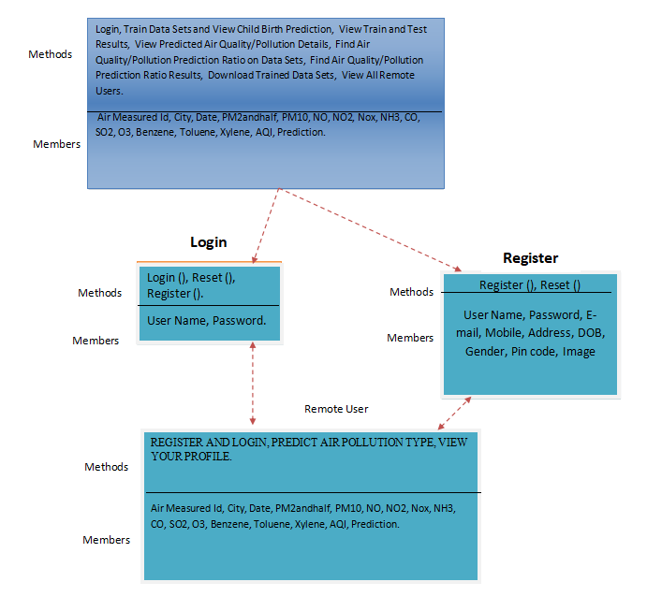
Uml Diagrams
Class Diagram
2/10

Slide 15
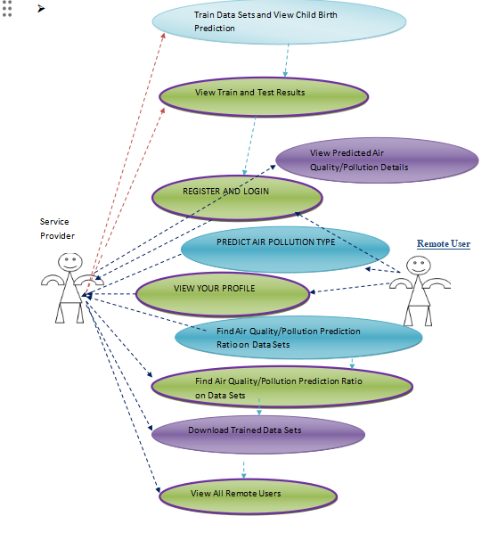
Uml Diagrams
Use Case Diagram
2/10

Slide 16
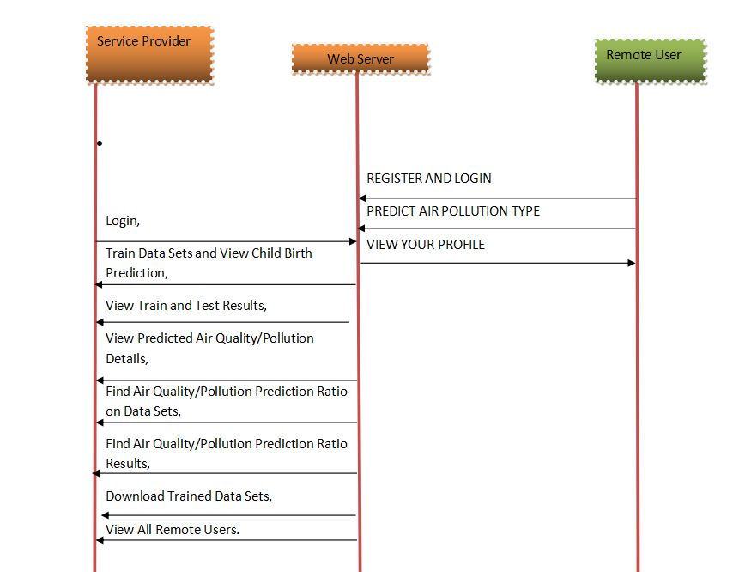
Uml Diagrams
Sequence Diagram
2/10

Slide 17
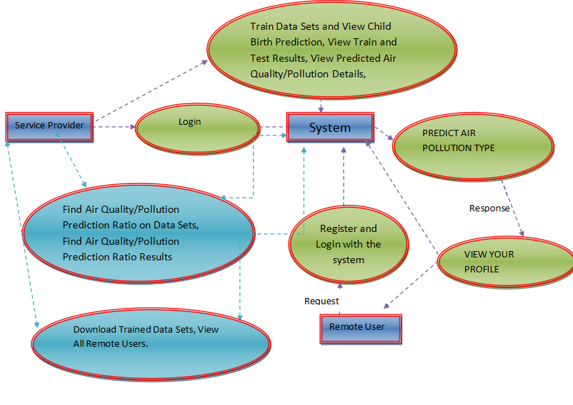
Data Flow Diagram
2/10

Slide 18
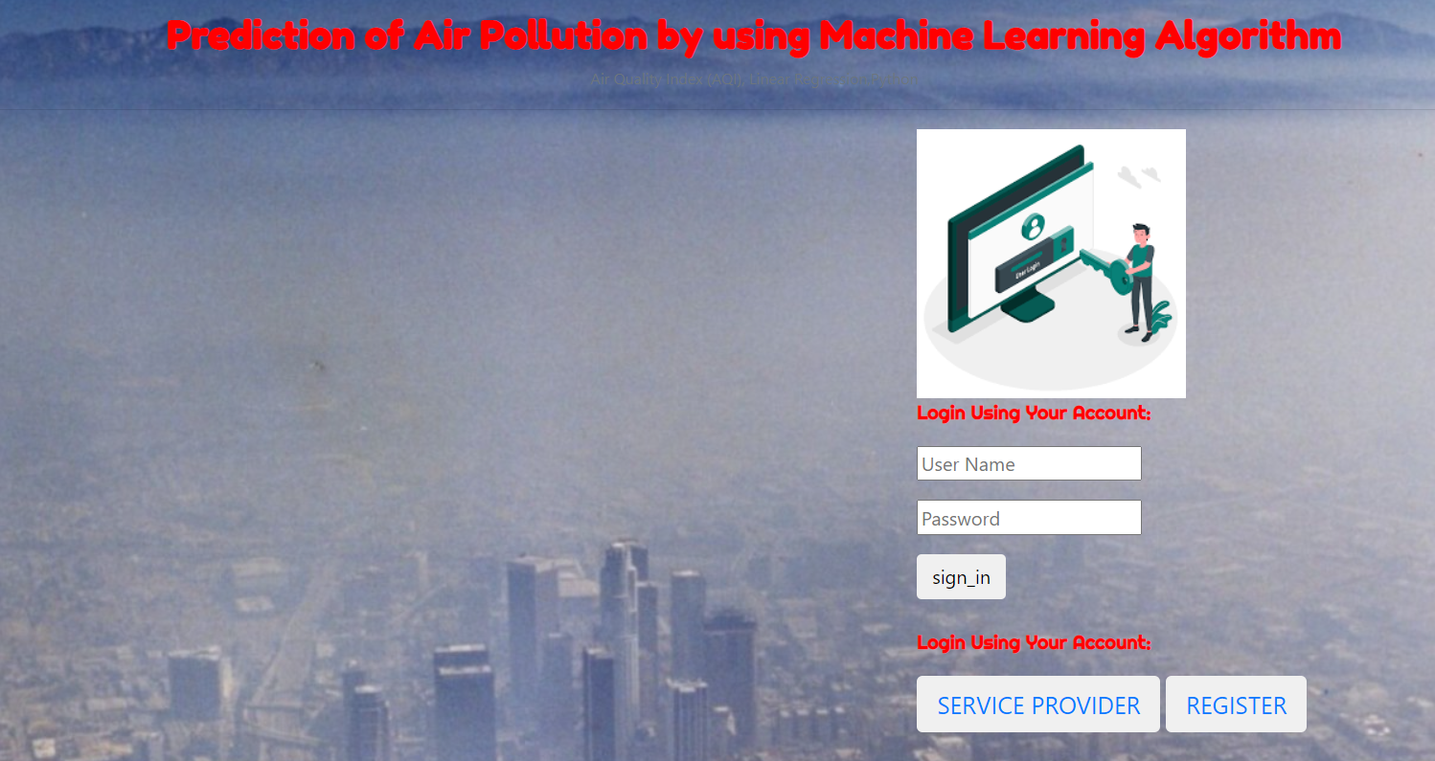
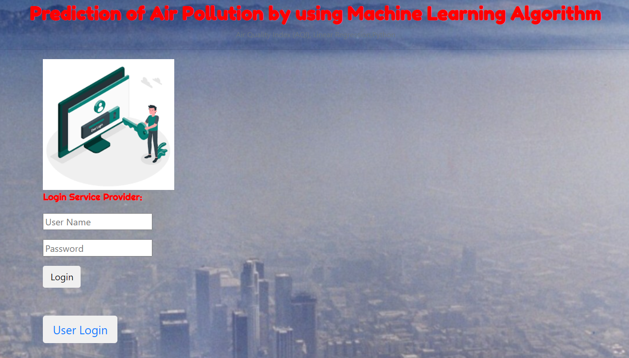
Screen Shots
2/10

Slide 19
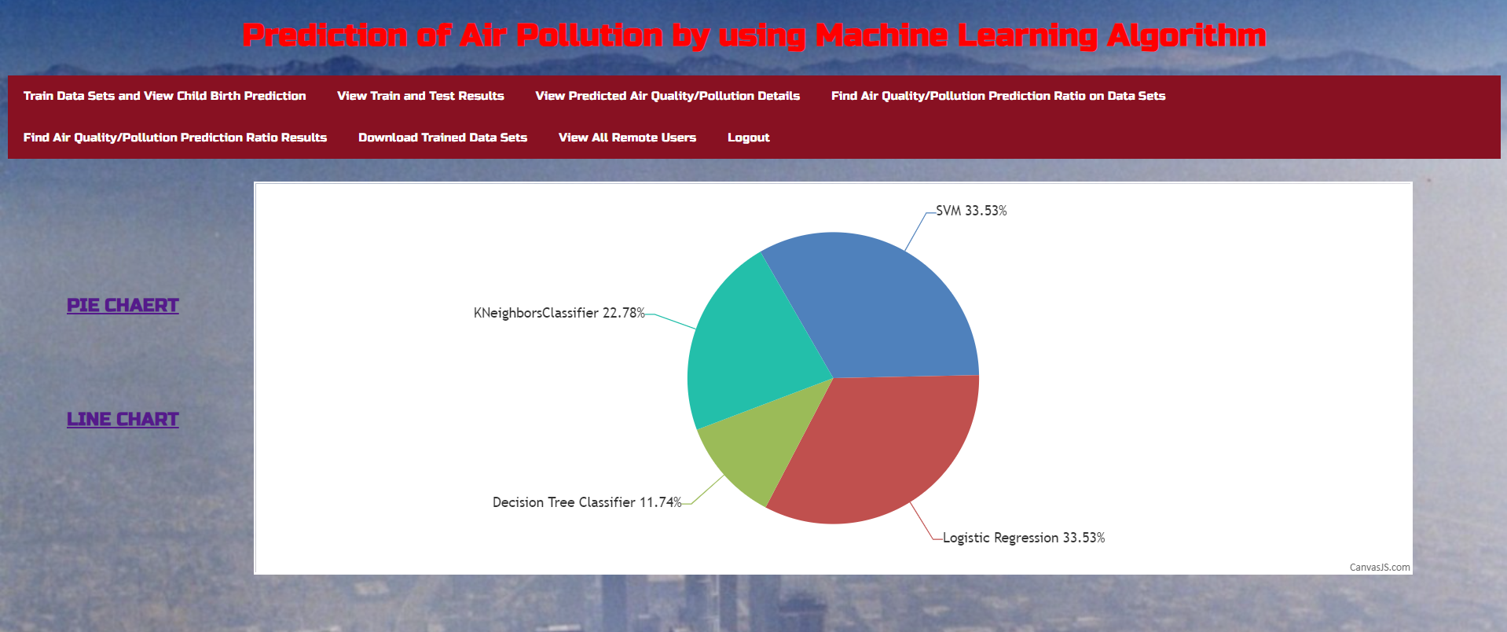
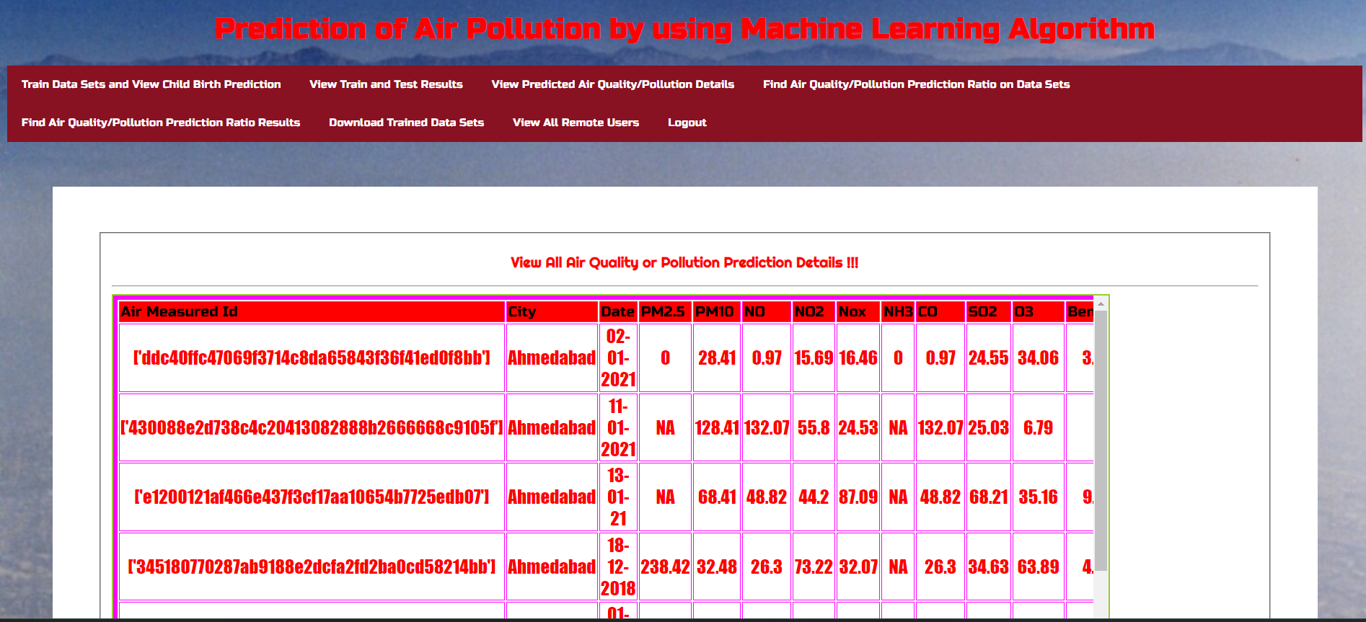
Screen Shots
2/10

Slide 20
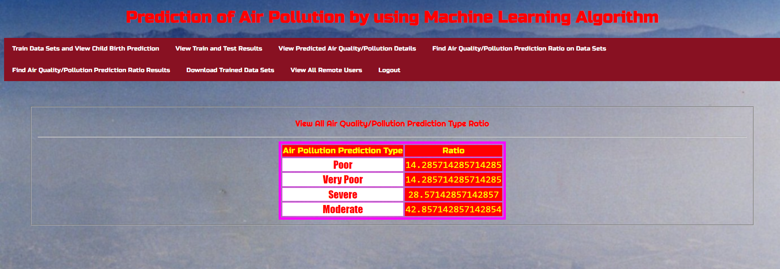
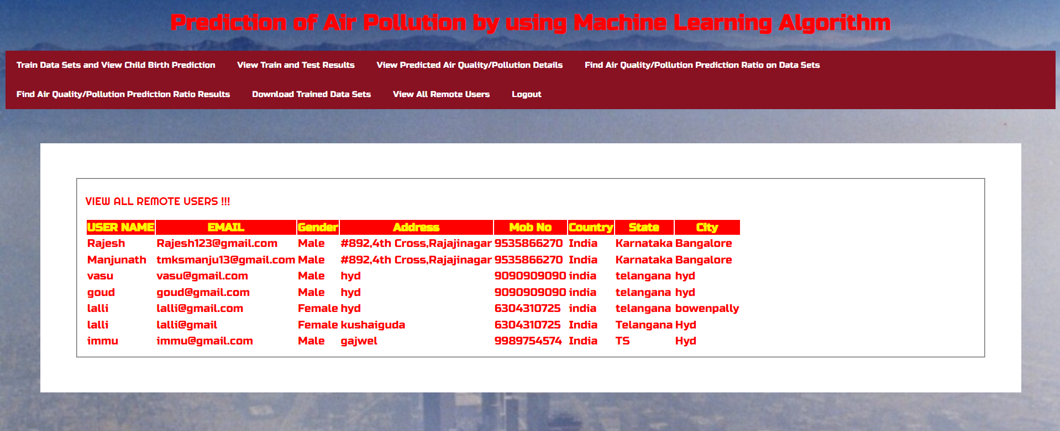
Screen Shots
2/10

Slide 21
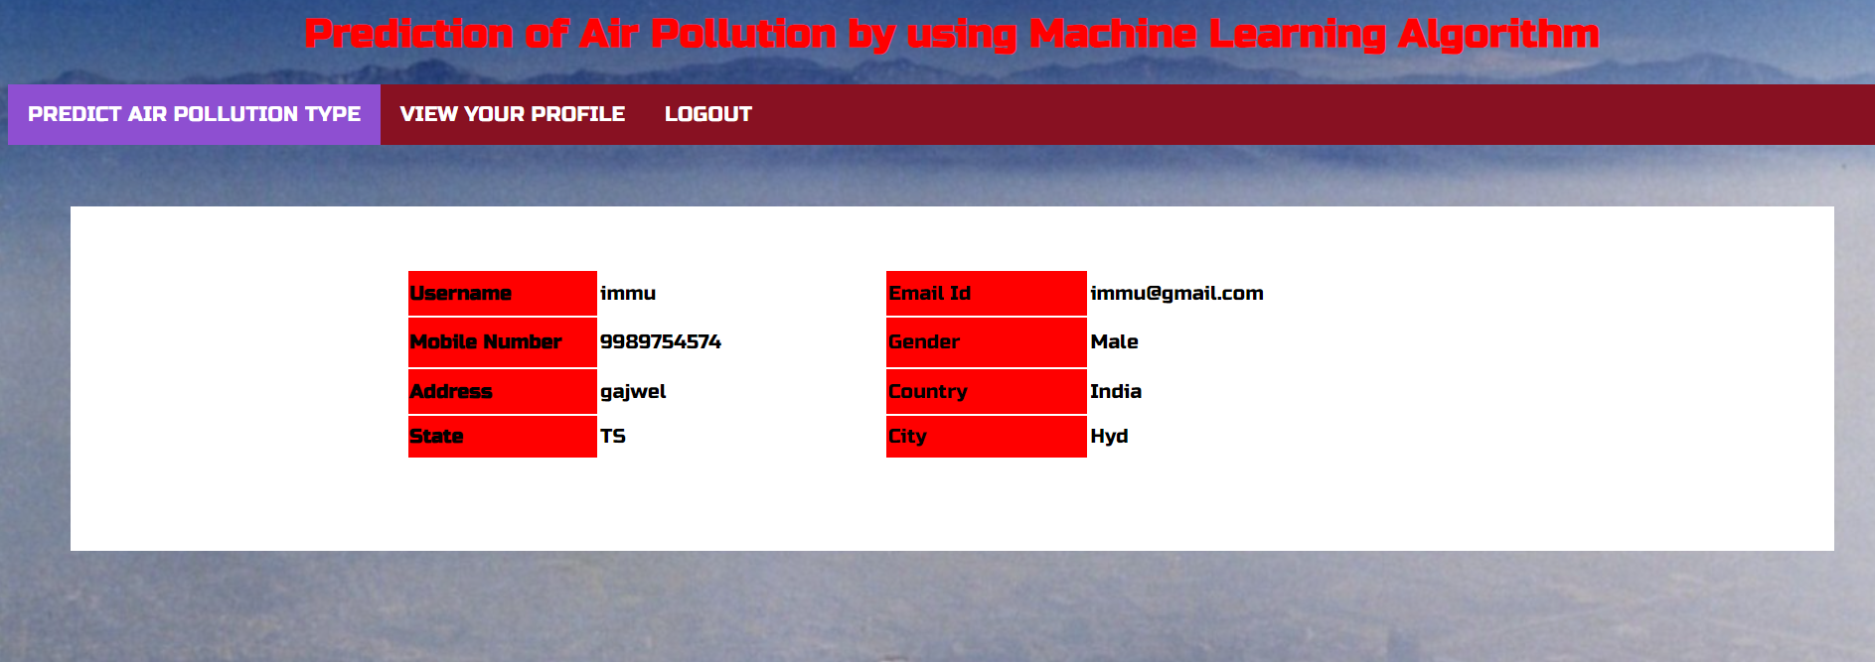
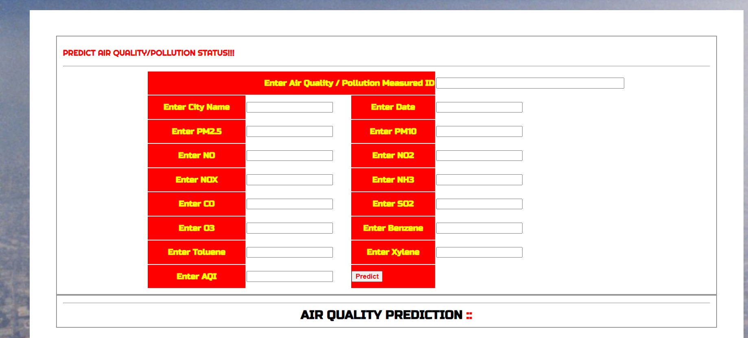
Screen Shots
2/10

Slide 22
Conclusion
Precision of our model is very acceptable. The anticipated AQI has a precision of 96%. Future upgrades incorporate expanding the extent of district and to incorporate whatever number locales as could be allowed as of now this venture targets foreseeing the AQI estimations of various areas of close by New Delhi. Further, by utilizing information of various urban areas the extent of this venture can be exhausted to anticipate AQI for different urban communities also
2/10

Slide 23
Bibliography
[1] Ni, X.Y.; Huang, H.; Du, W.P. “Relevance analysis and short-termprediction of PM 2.5 concentrations in Beijing based on multi-sourcedata.” Atmos. Environ. 2017, 150, 146-161.
[2] G. Corani and M. Scanagatta, "Air pollution prediction via multi-labelclassification," Environ. Model. Softw., vol. 80, pp. 259-264,2016.
[3] Mrs. A. GnanaSoundariMtech, (Phd) ,Mrs. J. GnanaJeslin M.E, (Phd),Akshaya A.C. “Indian Air Quality Prediction And Analysis Using Machine Learning”. International Journal of Applied Engineering Research ISSN 0973-4562 Volume 14, Number 11, 2019 (Special
Issue).
[4] Suhasini V. Kottur , Dr. S. S. Mantha. “An Integrated Model UsingArtificial Neural Network
[5] RuchiRaturi, Dr. J.R. Prasad .“Recognition Of Future Air Quality Index
Using Artificial Neural Network”.International Research Journal ofEngineering and Technology (IRJET) .e-ISSN: 2395-0056 p-ISSN:
2395-0072 Volume: 05 Issue: 03 Mar-2018
2/10

Slide 24
Thankyou
2/10

